Slide 1
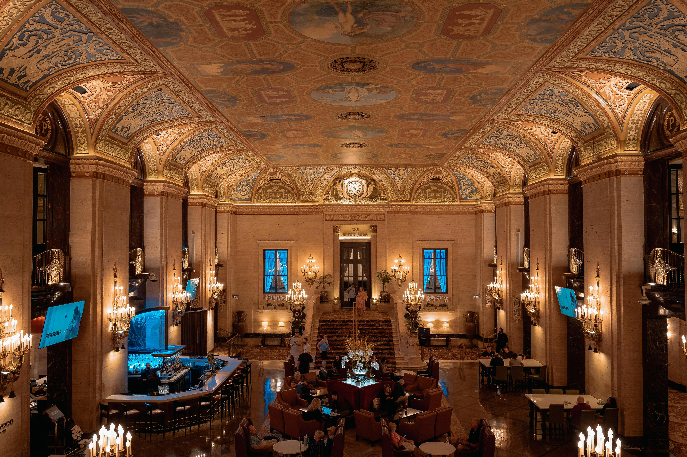
HOTEL BOOKING ANALYSIS
PREPROCESSING ON THE DATASET
SARA KHATAAM

Slide 2
DATASET OVERVIEW
Total Records: 36,285
Columns: 17
Objective: Predict booking status (Canceled or Not Canceled)

Slide 3

UNDERSTANDING THE DATA COLUMNS
Number of Adults & Children: Represents the guests in a booking.
Special Requests: Number of additional guest requests.
Number of Weekend & Week Nights: Length of stay.
Type of Meal: Meal plan chosen by the guest.
Car Parking Space: Indicates if parking was requested.
Room Type: Category of room booked.
Lead Time: Days between reservation and check-in.
Market Segment Type: Source of booking (e.g., online, offline).
Date of Reservation: When the booking was made.
P-C & P-not-C: Indicators for potential cancellation.
Booking Status: Target variable (Canceled/Not Canceled).

Slide 4
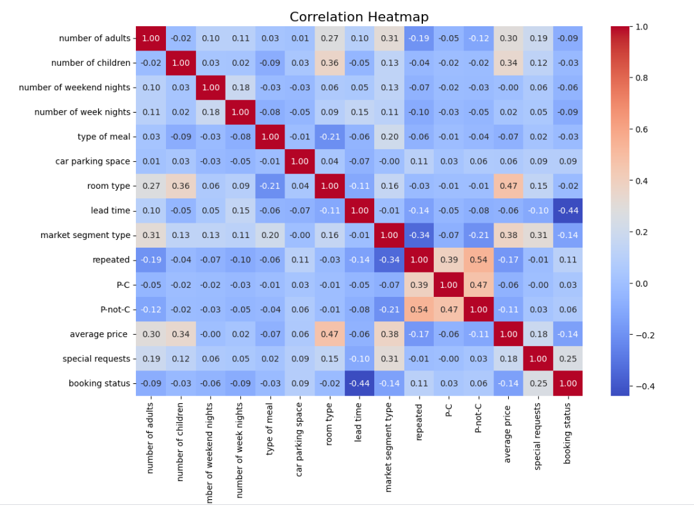
CORRE-LATION

Slide 5
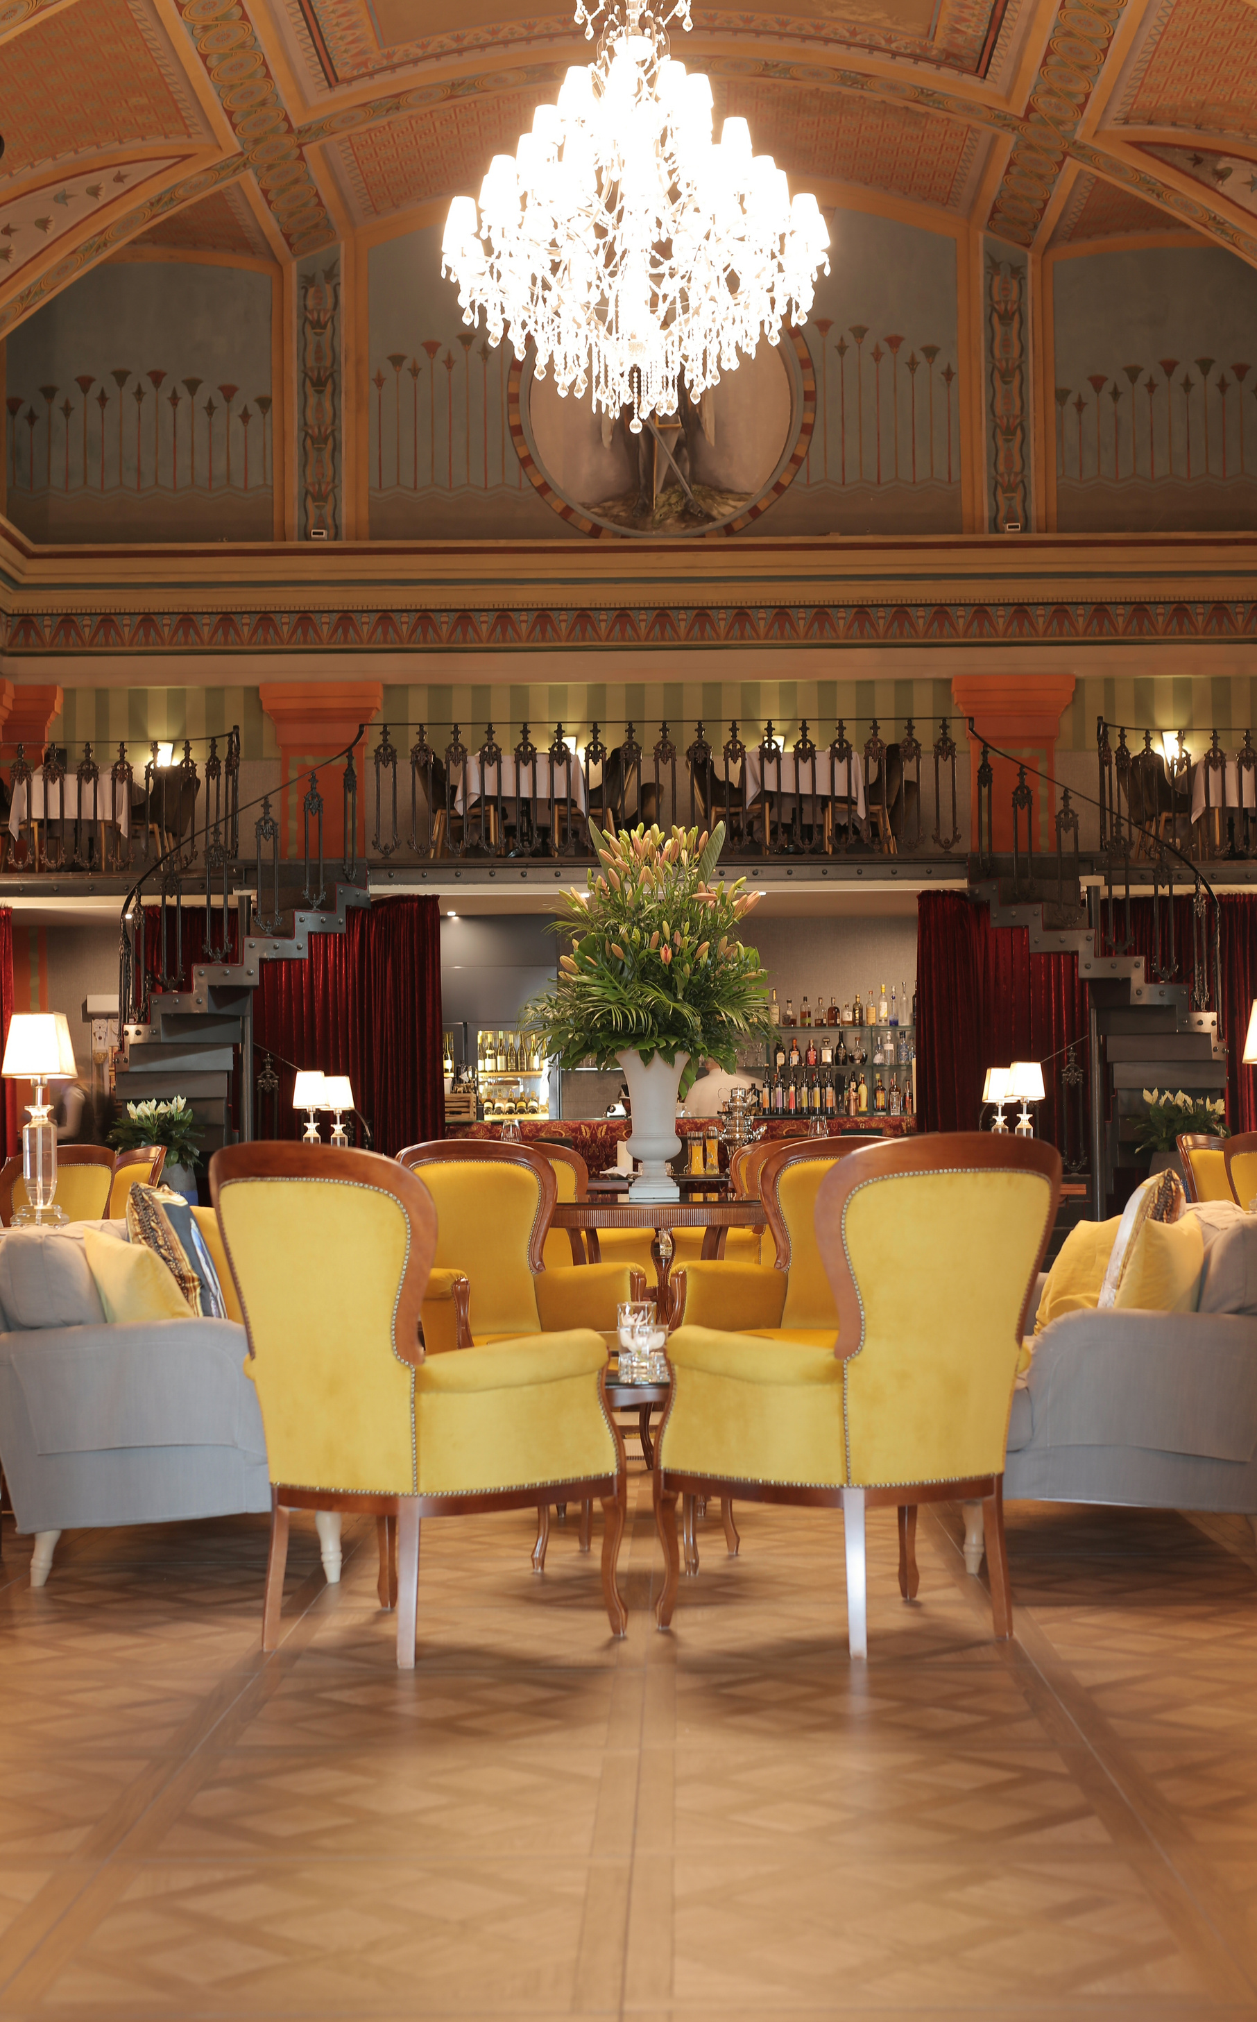
DATA PREPROCESSING & TOOLBOX USED
Handling Missing Data: No missing values detected
✅ Casting Features:
dropped Booking ID and date of reservation
✅ Outlier Treatment:
Used IQR method to remove extreme values in Lead Time & Average Price
✅ Encoding Categorical Variables:
Converted Room Type, Market Segment Type, Type of Meal and booking status into numerical values
✅ Handling Imbalanced Data:
Applied SMOTE oversampling to balance classes

Slide 6
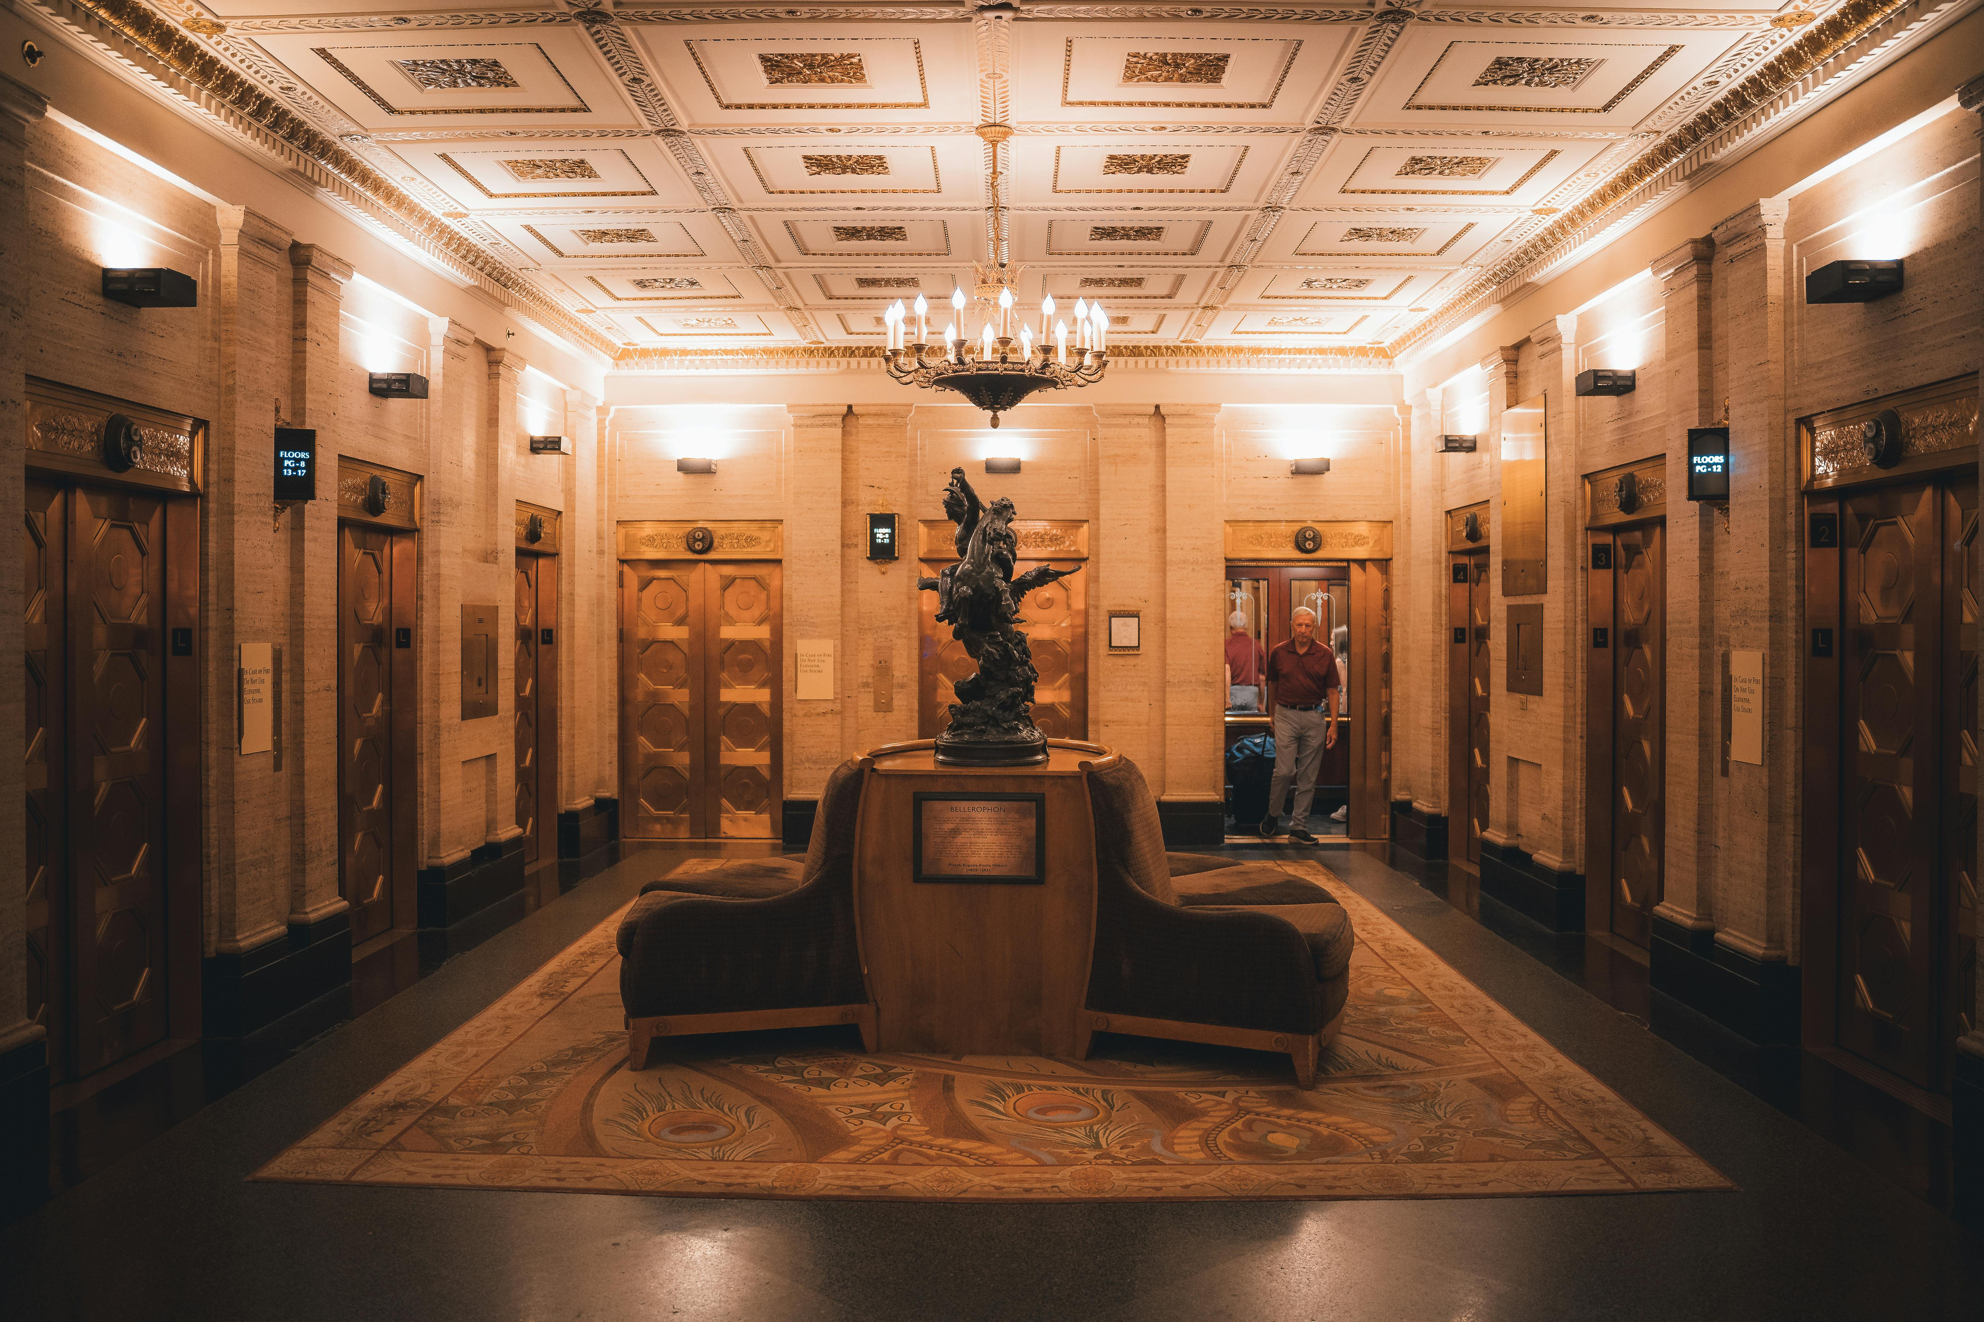
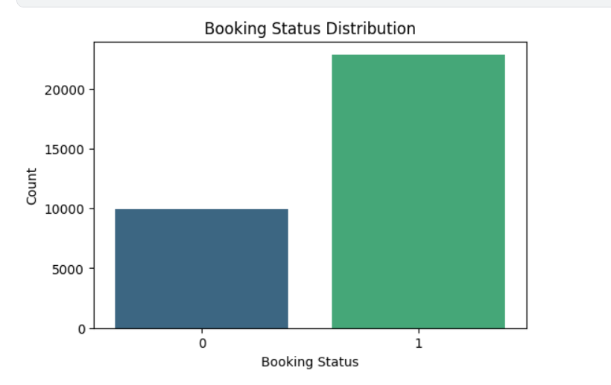
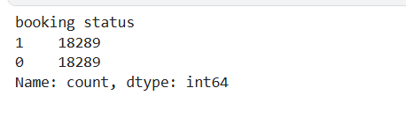
IMBALANCING
AFTER HANDLING

Slide 7

SUMMARY & NEXT STEPS
Understanding customer booking behaviors can help reduce cancellations.
Next Goal: Train & evaluate models for accurate cancellation predictions.
Link notebook
https://www.kaggle.com/code/sarakhataam/hotel-prediction
THANK YOU
BY SARA KHATAAM

